Slide 1
Getting from Here to There
Thomas Murray
Vice President of Customers and Communities

Slide 2
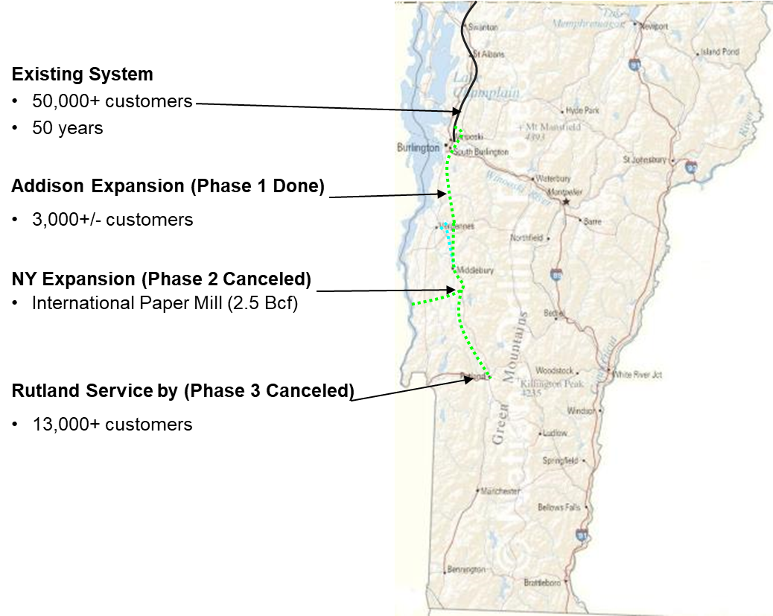
Vermont Gas Project Background
Vermont Gas completed a 41 mile
pipeline expansion in 2017
The most controversial Vermont
energy project in a decade

Slide 3
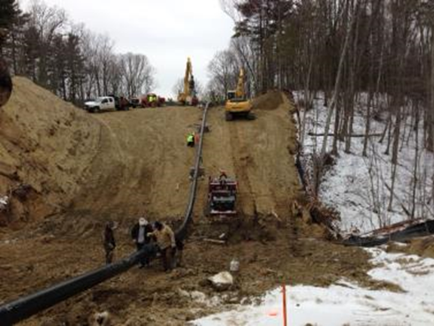
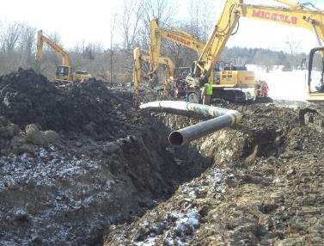
Project Challenges
Cost Increase ~$90m to $165m ($30m WO)
ROW (165 Landowners/Only 1 Eminent Domain)
Regulatory/Political
Protestor/Media
Company Image/Brand Tarnishing
Organizational/Employee Morale/Turn Over
Project Management/Contractors

Slide 4
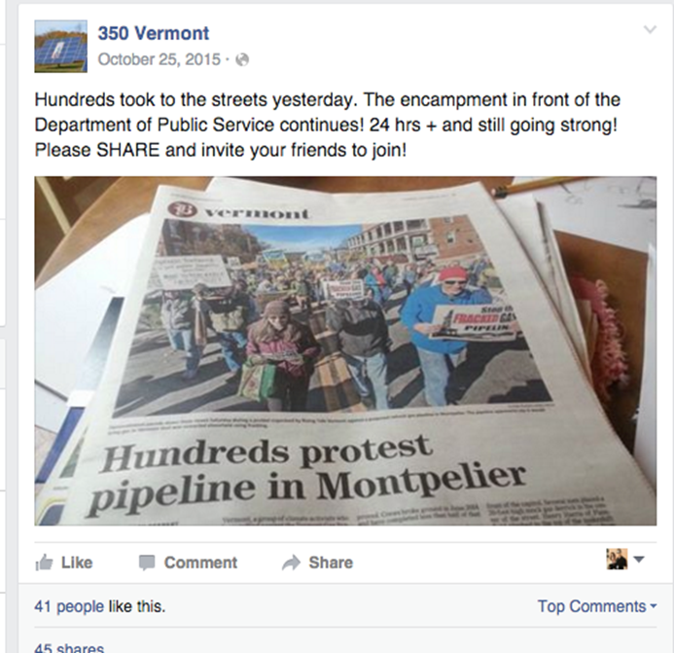
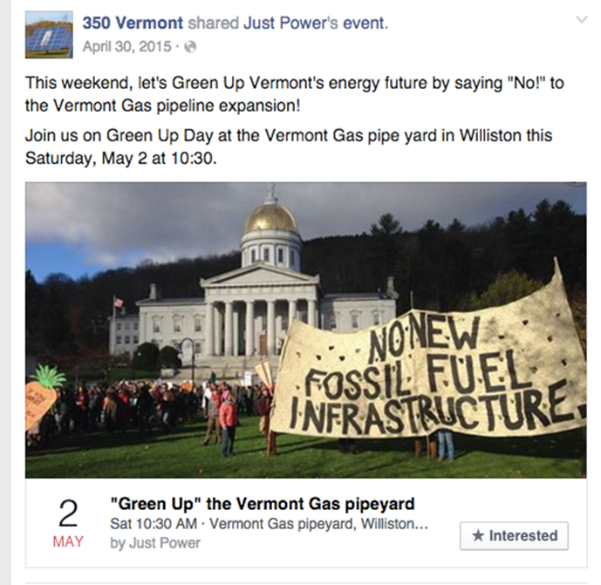
Protest Culture
Passionate opposition to Fossil Fuel infrastructure
Landowners opposed easements
Engaged local energy groups
Symbolic Climate Change Solution
Social Media/24 Hour News
Demographics-Young and Old

Slide 5
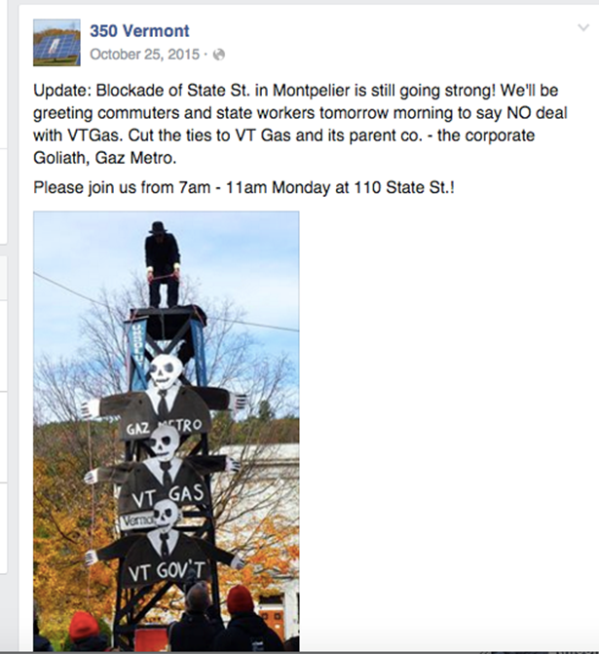
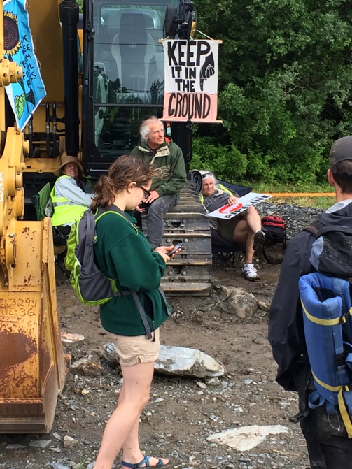
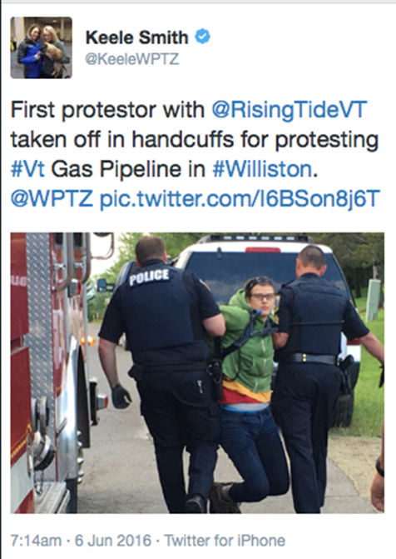
Company Image Under Assault

Slide 6
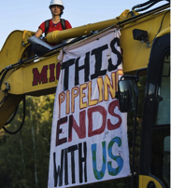
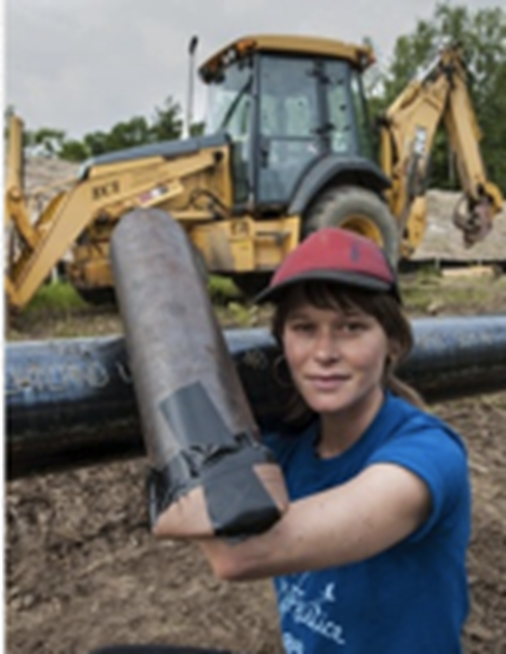
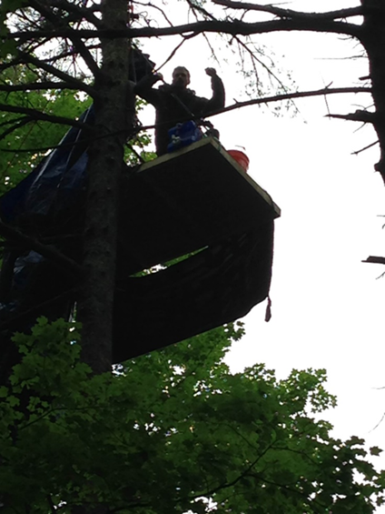
Protest Activities
Tree sitters
People chained to pipeline/equipment
Blocked access to pipe yard
Roof top access at VGS
Shut down of State Street, Montpelier
Protests at state and local hearings
Demonstrations at CEO and State Official homes.

Slide 7
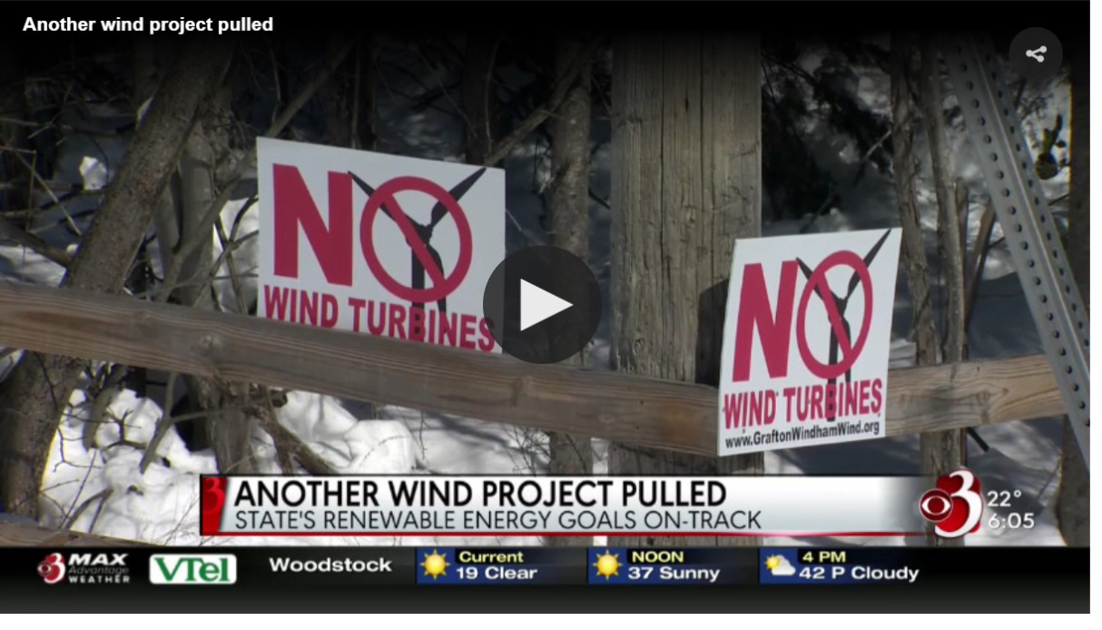
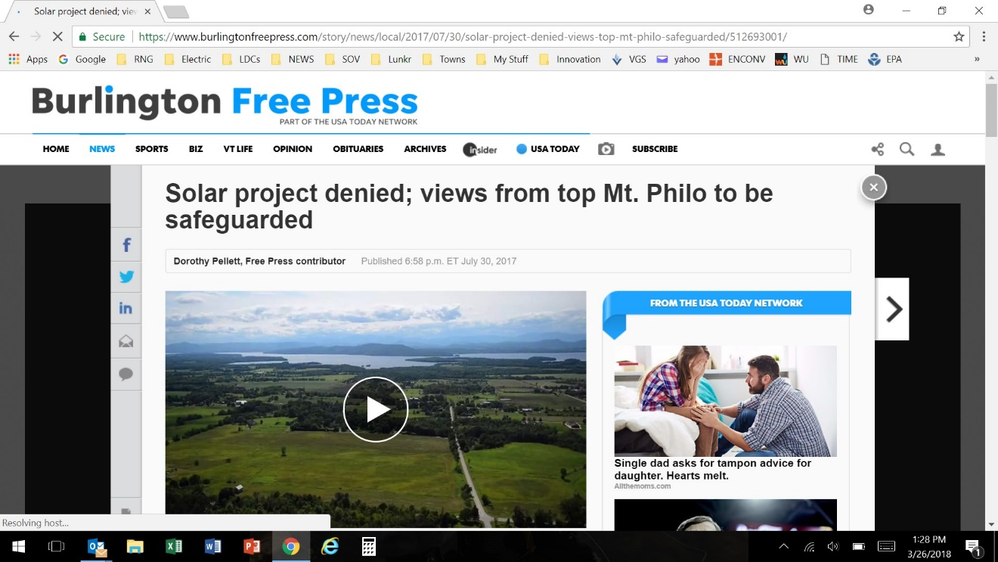
We’re not alone, wind and solar projects rejected

Slide 8
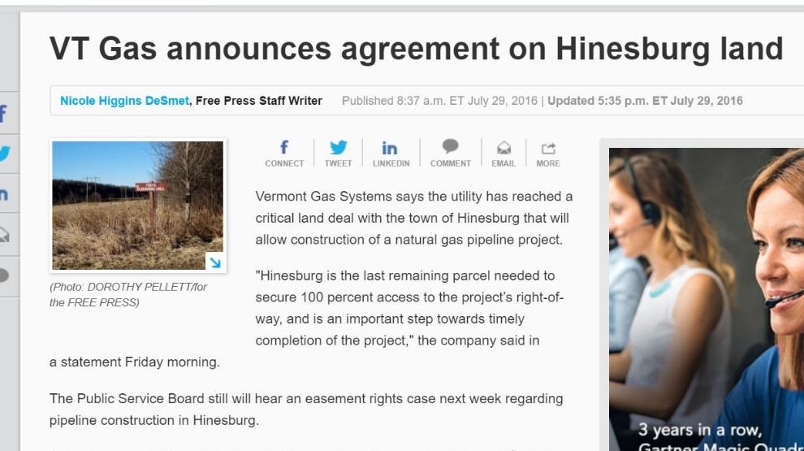
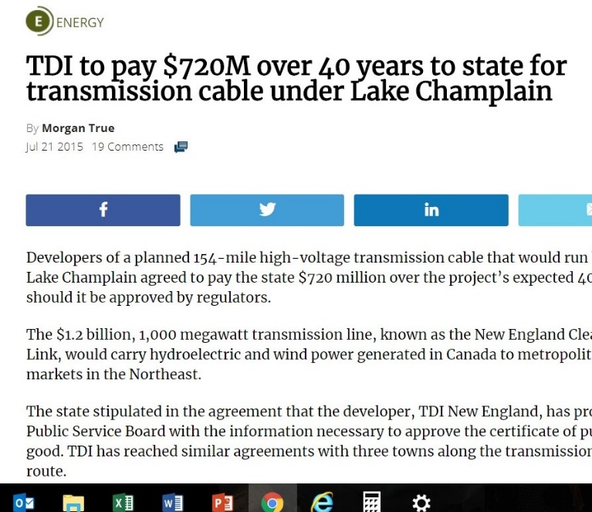
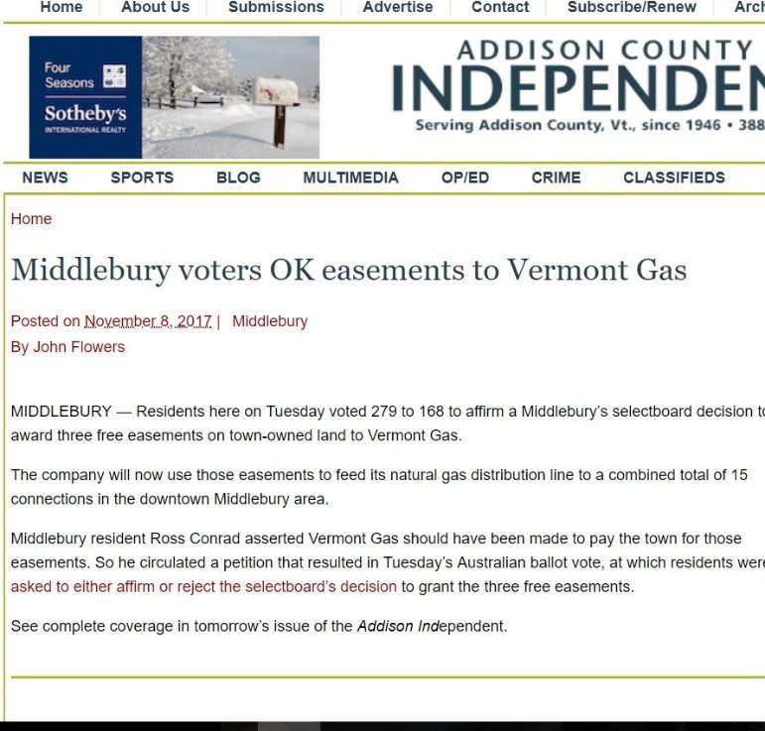
What does success look like?

Slide 9
Lessons Learned
Engage key stakeholders-early and often
Develop grassroots champions
Prepare for this project to run your business and life (for years)
Assemble an A+ Team with deep experience with pipeline projects of this size
Don’t believe your own BS, make sure you remain clear-eyed
Expect/Plan for success, prepare for failure
It has to be perfect…..compliance and accuracy at levels way above normal
Respect right to protest/maintain calm demeanor
Streamline media interactions/generate positive press (FOIA)

Slide 10
Questions

