Slide 1
New Hampshire’s Energy Infrastructure Corridors
IRWA New England Chapter
Fall Forum
October 18, 2018
Notes:
Good afternoon.
Thank you for inviting me to speak this afternoon regarding New Hampshire’s Energy Infrastructure Corridors.
I’m going to start with a little of the why, how we got here and where we are going.

Slide 2
Why Energy Infrastructure Corridors?
Notes:
So – why did the New Hampshire legislature enact legislation to create energy infrastructure corridors? There are a few reasons

Slide 3
Why Energy Infrastructure Corridors?
NH Highway Trust Fund Underfunded
Notes:
1 – New Hampshire’s Highway Trust Fund is underfunded and there is never sufficient dollars to meet the increasing needs to maintain our transportation network. The Legislature looked at this as a way to increase revenue without adding to the local tax burden

Slide 4
Why Energy Infrastructure Corridors?
NH Highway Trust Fund Underfunded
High Energy Costs
Notes:
2 – New Hampshire has relatively high energy costs.

Slide 5
Average Electricity Price
New Hampshire
Average retail price per kWh is 15.66 cents
Data for 2016
Notes:
Per data from the U.S. Energy Information Administration – energy in the Northeast ranges from 12.8 cents to 17.24 cents per kWh with New Hampshire at 15.66 cents.
The Legislature was looking for ways to improve the energy infrastructure and reduce energy costs. This in turn would help our businesses be more competitive and stay in New Hampshire rather than moving to those parts of the country with much less expensive energy. New Hampshire’s energy cost is 1 ½ times greater than the national average. Businesses complain about the high cost of doing business in the state and the cost of energy plays a big part in that.

Slide 6
Why Energy Infrastructure Corridors?
NH Highway Trust Fund Underfunded
High Energy Costs
Controversial Energy Projects
Notes:
And third – Opposition to controversial energy projects.

Slide 7
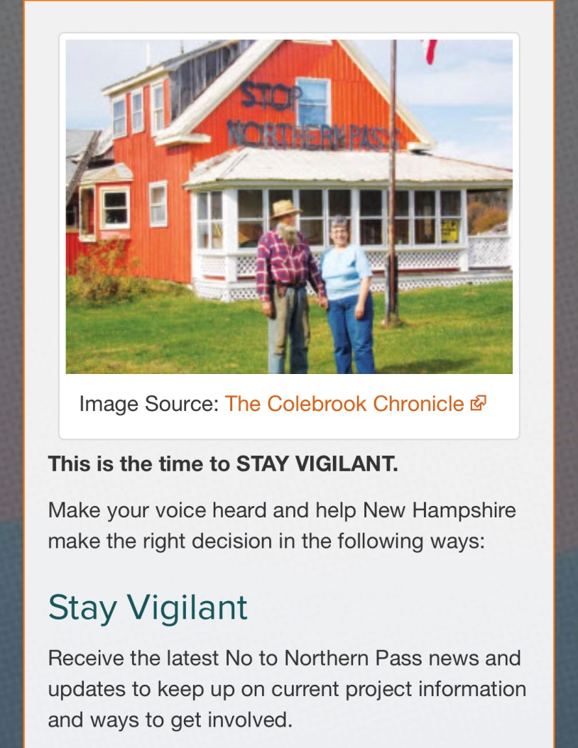
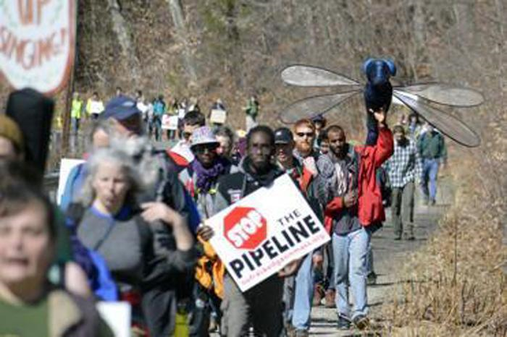
Notes:
One was Eversource’s Northern Pass project to bring hydropower from Quebec through New Hampshire’s scenic North Country to a substation in Deerfield to feed the New England grid.
The opposition saw this as a project that would degrade the natural and recreation resources of the state.
Another project being proposed at that time was Kinder Morgan’s Northeast Energy Direct or NED – a gas transmission line that would enter the state in the southwest corner and exit just north of Dracut Mass.
Both of these projects were seen as ones that would be detrimental to the state of New Hampshire with no benefit to the state.
Essentially “pass through” projects

Slide 8
HB 626
AN ACT authorizing energy infrastructure development and designating energy infrastructure corridors and requiring the department of transportation to adopt an updated and revised utility accommodation manual.
Notes:
The legislature introduced House Bill 626 in January 2015.
Took a while – originally deemed inexpedient to legislate
Ultimately was signed into law June 2016.
This created the energy infrastructure corridors and set up some guidelines for the department. The law also required that the Utility Accommodation Manual be updated to incorporate energy infrastructure corridors and obtain approval from the Federal Highway Administration for the updated manual by June 1, 2017. As we were in the process of updating our manual to address Federal Highway concerns, this effort was included.

Slide 9
What are Energy Infrastructure Corridors?
An existing state-owned transportation right-of-way within which energy infrastructure could potentially be sited underground.
Notes:
What are energy infrastructure corridors? Energy Infrastructure Corridors – As defined by RSA 162-R, an existing state-owned transportation right-of-way within which energy infrastructure could potentially be sited underground.

Slide 10
What are Energy Infrastructure Corridors?
The designated corridors are:
I-89
I-93
I-95
NH Route 101
Notes:
Mostly interstates:
I-89 (between the intersection of I-93 and the Vermont border).
I-93 (between the Massachusetts border and the Vermont border, excepting approximately 1.7 miles located in the White Mountain National Forest north of Franconia Notch state park).
I-95 (between the Massachusetts border and the Maine border).
N.H. Route 101 (between the intersection of I-93 and the intersection of I-95) – essentially from Manchester to the coast

Slide 11
What is Energy Infrastructure?
As defined by RSA 162-R includes high voltage DC or AC electric transmission facilities of 115 kV or greater, natural gas transmission lines, carbon dioxide pipelines, petroleum pipelines, and other energy transport pipelines or conduits.

Slide 12
Process as defined by statute
Developer submits request for conceptual feasibility study to NHDOT
Notes:
To start the process the developer files with the department a request for a preliminary conceptual feasibility study. This request will include project specific information that the department may specify.

Slide 13
Process as defined by statute
Developer submits request for conceptual feasibility study to NHDOT
NHDOT has 30 days to determine if request is sufficient to review
Notes:
Within 30 days, department to provide written notice to developer and the site evaluation committee either accepting the request is sufficiently complete to evaluate or specifying additional information is required.

Slide 14
Process as defined by statute
Developer submits request for conceptual feasibility study to NHDOT
NHDOT has 30 days to determine if request is sufficient to review
If sufficient then NHDOT has 60 days to submit report
Notes:
Upon determination that study request is sufficiently complete, the department then has 60 days to submit report on the conceptual feasibility of the project to the developer and the site evaluation committee That report shall specify any concerns or issues the department believes the committee should consider in its review of the application.

Slide 15
Process as defined by statute
Developer submits request for conceptual feasibility study to NHDOT
NHDOT has 30 days to determine if request is sufficient to review
If sufficient then NHDOT has 60 days to submit report
The project then follows the traditional SEC process
Notes:
Following that process, the site evaluation committee then shall review under RSA 162-H.

Slide 16
What makes the use of Energy Infrastructure Corridors different from any other energy facility?

Slide 17
Difference?
Generates Revenue
Notes:
Generates revenue for the Highway Trust Fund – the statute specifies that all revenue shall be used solely in state transportation programs funded in whole or in part by federal agencies and included in the 10 year transportation plan
The legislature did need to go back and amend the law to include any revenue within the turnpike system needed to go to turnpikes – but that’s a whole other discussion on the various pots of money….

Slide 18
Revenue
Per statute – the ROW Bureau Appraisal Section shall estimate a range of value for the use of state-owned land and then negotiate a value with the developer
Notes:
Per the statute – the Bureau of Right of Way Appraisal section will estimate a range of values for the use of state owned land. They will then negotiate a value with the developer and once they come to an agreement the actual and final value will be subject to approval by the Long Range Capital Planning and Utilization Committee.

Slide 19
Where are we now?

Slide 20
Where are we now?
UAM has been updated
Notes:
The UAM was updated and we have received FHWA approval. We used our experience with reviewing the plans for the Northern Pass project to update the manual as well as concerns raised by Northeast Energy Direct (NED)

Slide 21
Where are we now?
UAM has been updated
Formal process for review as been drafted
Notes:
We’ve drafted a formal process for reviewing projects using energy infrastructure corridors. Again using our experience with Northern Pass. This is still in a draft…. Glacial speed…. Working through internal review and approval

Slide 22
Where are we now?
UAM has been updated
Formal process for review as been drafted
Working through the process with Liberty Utilities
Notes:
Liberty Utilities saw the infrastructure corridors as a way to connect current transmission mains on the east side and central part of the state.

Slide 23
By New Hampshire. For New Hampshire.
Notes:
Liberty Utilities project is called Granite Bridge. The gas main would run along NH 101 from Manchester to Stratham. Goes through 2 DOT maintenance districts. They are also proposing a gas storage facility in Epping adjacent to the corridor.
Iterative process
LU – less info for conceptual plan
DOT – more info given the nature of plans we reviewed for NPT

Slide 24
Next Steps?
Notes:
Finalize process
Work through Granite Bridge project
Evaluate process and tweak if needed

Slide 25
Questions ???

Slide 26
Contact Information
Melodie Esterberg, PE
Chief of Design Services
New Hampshire Department of Transportation
7 Hazen Drive, PO Box 483
Concord, NH 03302-0483
(603) 271-2297
Melodie.Esterberg@dot.nh.gov

